Slide 1
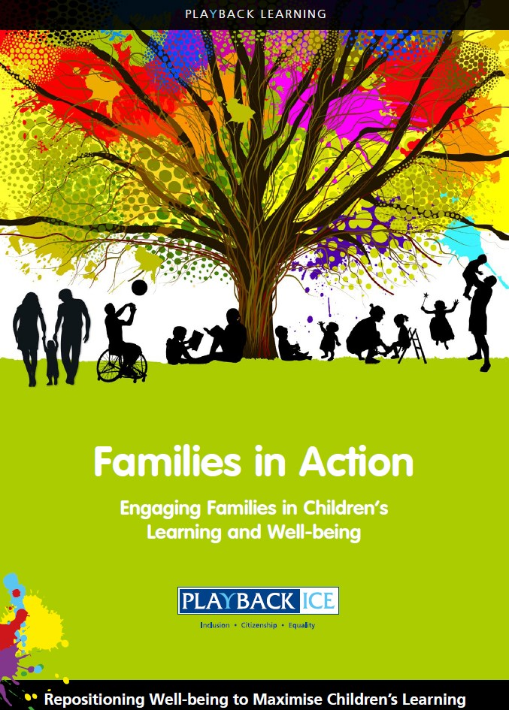

Families in Action
P L AY B A C K L E A R N I N G
A Family Wellbeing and Learning Resource
Enabling families to become more engaged in their children’s wellbeing and learning.
Contact: Liz Fitzpatrick, FRSA, CE, M: 07515346084 T: 01314535514
E: lizfitzpatrick@playbackice.com

Slide 2
Session 1:
How do we currently support our children’s learning and wellbeing?

Slide 3
Session 1: How do we currently support our children’s learning
and well-being?
Aims to:
Assess current levels of confidence in supporting their children’s learning and
wellbeing
Explore the importance of social and emotional wellbeing within the Health and Wellbeing curriculum and wider learning

Slide 4
Introduction
Involvement of families in supporting the school is crucial to ensure the best outcomes for all children.
What impact do parents/carers think they have on their children’s learning?
What levels of involvement can parents/carers have within the school?

Slide 5
Factsheet
Parental engagement is the best lever we have for school improvement and closing the attainment gap
When parents/carers and schools work together, children do better
Research suggests that up to 80% of the difference in children’s school
performance depends on their home and community environment
For all children, the quality of the home learning environment is more important for intellectual and social development than parental occupation, education or income

Slide 6
Factsheet
Checking homework, attending school meetings and events, and discussing school activities at home has a powerful influence on pupils’ academic performance
Achievement is not only reliant on what happens in school. what happens out of school, is equally important
Actively involving parents in the life of the school will help to promote a learning community in which pupils can engage positively with school staff and their peers

Slide 7
Factsheet
Schools benefit from developing positive partnerships with families by involving them in all decisions affecting their children’s education and learning
Families which develop a positive relationship of mutual trust and respect with the school enable effective communication that supports both them and their teachers
Families which share information with the school can assist teachers in adapting their teaching to suit the learning styles of their child/ren and take account of any issues that may exist

Slide 8
Review the parent evaluation questionnaire

Slide 9
Parent Evaluation Questionnaire
Questions: Are you confident….
In giving praise and encouragement to your child?
Listening and talking to your child?
In supporting your child’s learning at home?
In supporting your child to positively manage their emotions?
Spending quality time with your child each day doing something together? Encouraging your child to become independent?

Slide 10
The definition of wellbeing is broader than child protection and
how we tend to think about welfare. Aspects of wellbeing can include:
Physical wellbeing Economic wellbeing
Social wellbeing
Development and activity
Emotional wellbeing
Psychological wellbeing
Life satisfaction

Slide 11
Summary:
Feelings of wellbeing are fundamental to the overall health of any individual, enabling them to successfully overcome difficulties and achieve what they want out of life.
Past experiences, attitudes and outlook can all impact wellbeing as can physical or emotional trauma following specific incidents.
Each child is unique and there is no set level of wellbeing that children should achieve.
Each child should be helped to reach their full potential as an individual.

Slide 12
Summary:
The Children and Young People (Scotland) Act 2014 is a key part of the Scottish Government's strategy for making Scotland the best place in the world for children to grow up.
By facilitating a shift in public services towards the early years of a child's life and towards early intervention, whenever a family or young person needs help, the legislation encourages preventative measures, rather than crises' responses.
This is underpinned by the Scottish Government's commitment to the United Nations Convention on the Rights of the Child 1989 (UNCRC) and the national approach, Getting it right for every child (GIRFEC).

Slide 13
Issues impacting on children’s health and wellbeing:
How do parents/carers support their child’s health and wellbeing e.g. exercise, healthy eating, getting enough sleep, social activities, clubs or emotional support?
What barriers do parents/carers experience to support their child’s wellbeing
and learning?
How can we work together to share advice and information on ways to
support children’s wellbeing?

Slide 14
Topic(s) for discussion – what can we improve?
Is homework or learning supported at home causing any difficulties for children?
Is the use of mobile phones a problem?
Can the children access after school activities?

Slide 15
Discussion on:
National Improvement Framework HWB Curriculum
The ICE Pack Resource Knowing Me, Knowing You

Slide 16
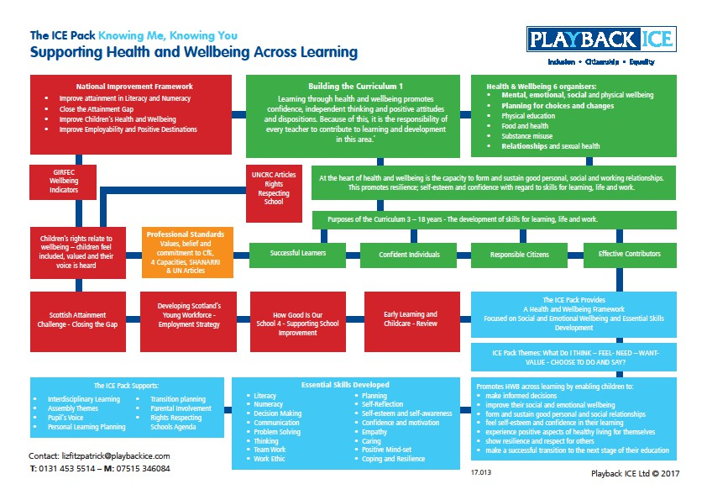

Slide 17
The 6 HWB Curriculum organisers from CfE includes:
Mental, emotional, social and physical wellbeing
Planning for choices and changes Physical education
Food and health
Substance misuse Relationships and sexual health

Slide 18
Discuss how the school supports the delivery of the HWB organisers 2 – 6
What is working well in the school?
What plans does the school have in relation to these aspects of HWB?

Slide 19
How does the school enable the CfE HWB Organiser 1:
Mental, social and emotional wellbeing of children’s HWB to be embedded in
learning?

Slide 20
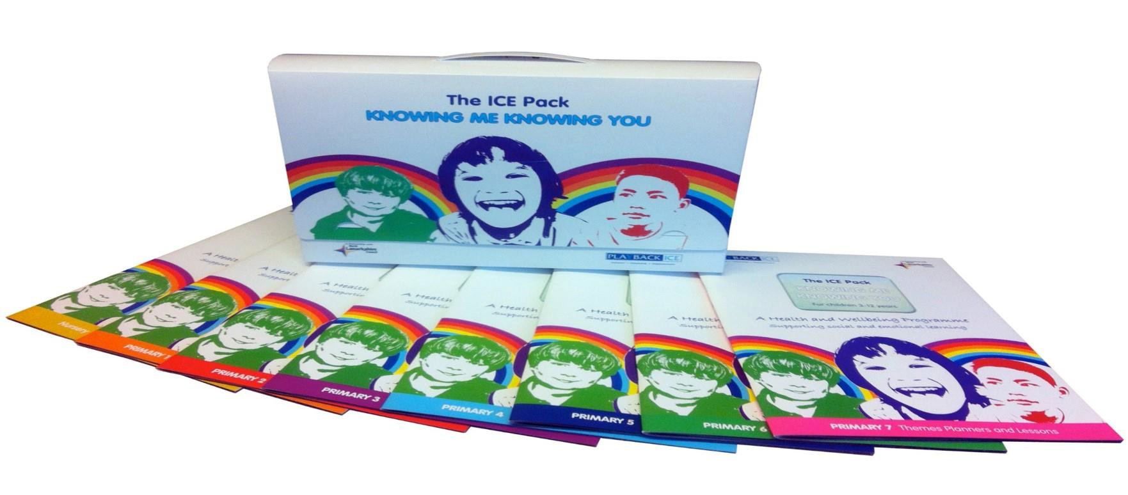
The Knowing Me, Knowing You Resource
Enabling Social and Emotional Wellbeing - Skills Development – Pupil Voice

Slide 21
The resource has been designed to support:
The core principles of CfE HWB Across Learning (E&Os) The Girfec Agenda
The 4 Capacities
Rights Respecting Schools Agenda Pupil Voice
Digital Skills Development for Staff and Pupils Pupil Profiling

Slide 22
The resource supports:
A Nurturing Inclusive Approach Resilience Building Interdisciplinary Learning Assembly Themes
Transition Planning Parental Participation

Slide 23
The programme offers
A building block approach to children’s learning.
Supports professionals in addressing and delivering the social and emotional well-being needs of young learners.

Slide 24
Pre-planned Lessons Themes
What do I:
Feel
Need Want Think Value
Choose to do and say

Slide 25
The resource includes:
A Nursery Lesson Book
Primary 1 - 7 Lesson Books
Mojo and Friends – A Fully Illustrated Story Book A Resource Wall Planner
GIRFEC Planning Tool

Slide 26
For review:
The Knowing Me, Knowing You Resource materials
Pupil Equity Fund Chart for interest and information The Resource linked to GIRFEC Sample

Slide 27
Statement:
Playback believes social and emotional wellbeing is the most crucial aspect to prepare children for learning – if they feel ‘healthy and happy’ they will learn.
Priority:
Reposition children’s wellbeing to maximise their learning

Slide 28
Feedback/closing summary

